Slide 1
National Institute of Open Schooling(NIOS)
(Largest Open Schooling System in the World)
Diploma in Elementary Education (D.El.Ed)
Training Programme for untrained in-service Teachers in Elementary Schools
Capacity Building Cell
NIOS
<number>
Notes:
<number>

Slide 2
NIOS at a Glance
An Autonomous Institution under Department of SE&L, MHRD, Govt. of India, established in 1989.
Offers Courses at Elementary level (Open Basic Education), Secondary,Sr. Secondary level and number of Vocational courses through ODL Mode.
Authorised for conducting Examination for certification at pre-degree level as per Gazette Notification issued by GoI
Operates through a network of 22 Regional Centre and more than 6500 Study Centres.
Cumulative Enrolment of 28.2 Lakhs with 5.50 Lakhs Enrolment every year.
Resource Organization for Open Schooling – 17 State Open Schools.

Slide 3
Objectives of D.El.Ed Prog.
Enable the teachers to understand and address diversity in his/her context;
Empower teachers to improve quality of classroom processes/transaction;
Develop understanding to promote child friendly, child centered processes in school;
Familiarize the teachers with appropriate teaching learning processes;
Facilitate teachers to develop leadership & problem solving skills among children;
Sensitize teachers to make children aware of child rights and related issue.
Notes:
<number>

Slide 4
Eligibility for the Course
Teacher should be Untrained In-Service in any Govt. or Govt.Aided or Private Unaided School.
Senior Secondary/Class 12th with 50% marks in aggregate.
For SC/ST/OBC/PH candidates a relaxation of 5% marks is admissible.
If the teacher is Graduate still the 50% or 45% marks at class XII is applicable.
Two Years experience of teaching.
<number>

Slide 5
Improvement of Percentage at Class XII
NIOS Provides a chance for Improvement.
For Improvement register online at NIOS Senior Secondary Course under Stream 1 as part Admission in 1 – 4 subjects, i.e maximum upto 4 Subjects from the same subject combination the teacher has studied.
If the teacher is Graduate still the improvement of marks at class XII is applicable.
On Passing Senior Secondary, Improvement Mark Statement will be issued.
D.El.Ed. Certificate will be issued only after the Teacher has secured 50% or 45% Marks or above in Senior Secondary.
<number>

Slide 6
Relaxation Accorded by NCTE
One time relaxation to the mandatory condition of two years of teaching experience to pursue D.El.Ed through distance mode.
All Teachers appointed on or before 10th August 2017 are eligible for the NIOS D.El.Ed prog.
The duration of the programme reduced to 18 months instead of 2 years.
The requirement of 6 months Internship to be subsumed within the duration of 18 months.
The end date for obtaining the essential diploma is 31st March 2019

Slide 7
Relaxation Accorded by NCTE
Relaxation in the intake capacity in D.El.Ed.(ODL) programme to enable NIOS to train the any required number of Untrained In-Service Teachers.
NIOS shall operate study centres manned by staff (academic & others) as per instructions of MHRD to complete the training of in-service untrained teachers all over India by 31st March 2019.
NIOS to administer the training programme through SWAYAM portal of MHRD.

Slide 8
Duration of the Programme
The programme was launched on 3rd October, 2017 by the Hon’ble HRM Sri Prakash Javdekarji and will be completed by 31st March,2019 i.e. the period of the extension under the amendment to the Act.

Slide 9
Programme Fee
Fee @Rs. 6000/- per year is chargeable per learner.
Rs.1500/- has been exempted to enable the teachers to procure the DISH TV to watch SWAYAMPRABHA (DTH Vagda Channel no. 32) for the D.El.Ed course.
The balance of Rs.4,500/ was paid online by the teachers as the First Year Course Fee.
Second year fee will be Rs. 6000
Examination fee of Rs.250/- per subject per attempt will be charged.

Slide 10
Course Structure Ist Year (Total 32 Credits)
Group I – Contextual Issues
Code | Title of the Course | Theory + TMA (Mrks) |  | Credit T+P=Tot
501 | Elementary Education in India: Social Cultural Perspective | 70 +30 | 3+1=4
502 | Pedagogic Process in Elementary schools | 70 +30 | 6+2=8
Group II – Compulsory Teaching Subjects
503 | Learning Languages at Elementary Level | 70 +30 |  | 3+1=4
504 | Learning Mathematics at Elementary Level | 70 +30 | 3+1=4
505 | Learning EVS at Primary Level | 70 +30
3+1=4
Group – IV - Practical Courses
511 | School – Based Activities | 100 |  | 4
512 | Workshop – Based Activities | 100 |  | 4

Slide 11
Course Structure 2nd Year (Total 32 Credits )
Code | Core Courses (Group –I & II) | Theory+ TMA(Mrk) |  | Credit T+P=Tot
506 | Understanding Children in inclusive context | 70 +30 | 6+2=8
507 | Community & Elementary Education | 70 +30
3+1=4
508 | Learning Art, Physical and Work Education at Elementary level | 70 +30
3+1=4
Group III – Optional Teaching Subject (Any one)
509 or 510 | Learning Social Science at Upper Primary Level OR | 70 +30 |  | 3+1=4
Learning Science at Upper Primary Level | 70 +30 |  | 3+1=4
Practical Courses (Group –IV) Pr. Mrk
513 | Workshop – Based Activities | 100 |  | 4
514 | Practice Teaching | 100 |  | 8

Slide 12
Delivery Strategies for Competency Development
Programme consist of 64 credits which includes 750 study hours of self study, practical and contact sessions
Workshop based activities
(one each for 12 days in a year) 8 Credits 240 hours
Pre workshop Activity 52 hours
Workshop Activity (12 days x 7 hrs x 2 yrs) 168 hours
Post workshop Activity 20 hours
School Based Activities 4 Credits 120 hours
Practice Teaching
(40 lessons x 6 hours each) 8 Credits 240 hours
(6 hrs include the time for preparation of lesson plan & TLM, discussion with mentor/supervisor, delivery of lesson and feedback)
Tutoring/PCP support 150 hours
Total Contact Hours: 750 hours

Slide 13
Muti-Channel Delivery Strategies
Course Materials uploaded on NIOS portal | SWAYAM Platform Offering 14 Courses at Secondary level. D.El.Ed courses will be offered in 4 quadrant
Audio / Video materials
Inputs through organizing Workshops | SWAYAM PRABHA DTH Channel 3 Channels allocated Channel 27 for Secondary, Channel 28 for Sr.econdary & Channel 32 for Teacher Education
Interactive radio counseling – Mukta Vidya Vani
Mobile App – NIOS_D_El_Ed
Videos on YouTube Channel
Translation in Regional Languages: Besides Hindi & English
Telugu, Assamese, Gujrati, Kannad, Malyalam, Marathi, Odia, Tamil, Bengali, Punjabi

Slide 14
Evaluation
Continuous Evaluation
Self Evaluation through Print Modules
Course based Assignments (both for theory & practical courses)
Development of Portfolio
Project Work – Group & Individual
School based Practical Activities
Record evaluation on working with children
Terminal Examination for both theory & Practical Courses
Assessment of Practice Lessons

Slide 15
Capacity Building of Functionaries
Sl.No | Activity
I | Orientation of Study Centre Coordinators & Master Trainers by the Experts from NIOS
II | Orientation of Resource Persons by Master Trainers

Slide 16
Teaching Learning Schedule
SI.No. | Activity
I | Registration on SWAYAM MOOCs platform of MHRD. Three Courses 501,502 & 503 available on SWAYAM in 4 quadrant. Course Coordinators for three courses identified. D.El.Ed Videos are telecast on SWAYAMPRABHA DTH Vagda Channel no 32 available through DD Free Dish or Dish TV Set top Box.
II | Personal Contact Programme ( 15 days) each year
III | Submission of Assignments
IV | School Based Activities (SBA)
V | 12-Days Workshop each year
VI | Examination

Slide 17
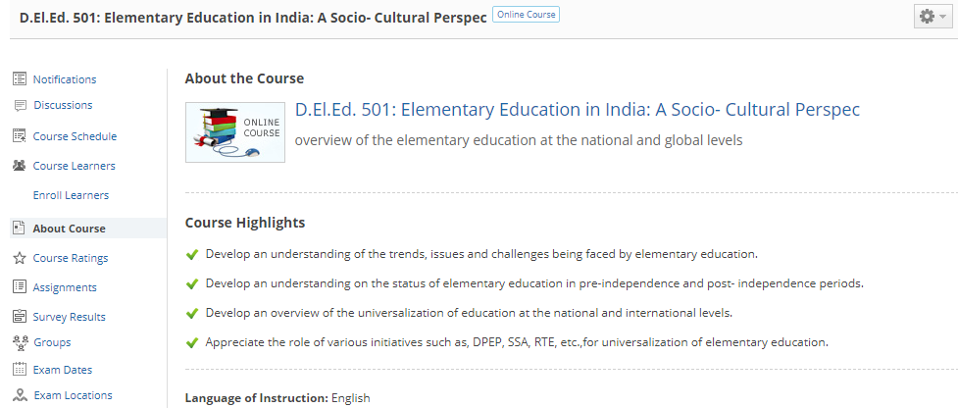

Slide 18
PCP, ASSIGNMENT AND PRACTICAL ACTIVITIES OF D.EL.ED. PROGRAMME
<number>

Slide 19
Personal Contact Programme (PCP)
PCP is an inseparable component in open and distance learning (ODL).
30 PCPs (15 PCPs each year) during whole programme.
It is mandatory for all learners and 75% attendance is compulsory for appearing the term-end examination
PCP tutorials are spread over Sundays and other holidays or vacation
<number>

Slide 20
Course Based Assignments/TMA
Course Based Assignments are the integral and compulsory component.
Assignments are available on the NIOS Web portal and at SWAYAM Portal.
There are assignments in every theory course. These assignments are to be submitted to the concerned Study Centre.
Only hand written TMA should be submitted.
There will be three course based assignments (2 theory + 1 practical) carrying a weightage of 30 percent in each course. Practical based will carry 10 percent and theoretical item will carry 20 percent weightage . All the items will be compulsory. In toto there will be 27 assignments for whole programme.
<number>

Slide 21
Practical Activities
School Based Activities (SBA) only 1st year (Code 511)
Workshop Based Activities (WBA) I & II (Code 512 & 513)
Practice Teaching (PT) 2nd year (Code 514)
<number>

Slide 22
School Based Activities (SBA) - (Code 511)
Trainee need be engaged in School Based Activities in his/her workplace(school).
Coordinate with Headmaster, Mentors and Supervisors.
School based activities managed by Mentors with the Trainees and evaluated by Mentors/Supervisors.
The three types of School Based Activities are – Case study of a school child, Maintenance of school records and registers and contribution to school programme
After getting the marks from the Mentors/Supervisors, the marks will be recorded in the Register and the same need be submitted to Regional Centre as per the schedule.
<number>

Slide 23
Workshop Based Activities (WBA-I & II) – Code 512 & 513
One of the important activities of the Study Centre Coordinator is to organize Workshop Based Activities for 12 days each year of the Programme
Schedule of WBA will be available on NIOS Web portal to be uploaded by the study centre coordinator
Coordinators need to make a list of materials to be brought to the workshop by the Teacher Trainee (Chart Papers, Flannel Boards, Pencils, Eraser, Sketch pens, Crayons, Plain sheet Papers(500), Marker, James clips, Gum, Portfolio for evaluation, Carbon paper, Chalks, Duster etc.)
<number>

Slide 24
Practice Teaching (PT) – (Code 514)
To acquire the techniques of writing better lesson plans.
To acquire the skills of delivering the lesson effectively as per the lesson plans in classroom.
The whole PT exercise involves 8 credits equivalent to 240 hours in respective working school.
The practice teaching will be organised under the guidance of a mentor and a supervisor.
Altogether 28 lessons (7 lessons in each subject area – Language, Mathematics, Environmental Studies, Science/Social Studies)
Classes are to be delivered in both Mono grade and multigrade/multiple class contexts
<number>

Slide 25
Delivery of lesson during Practice Teaching
Name of the Subject | No. of lessons to be evaluated By Mentor | No. of lessons to be evaluated by Supervisor | Total Lesson Plans
Language | 5 out of 7 | 2 out of 3 | 10
Mathematics | 5 out of 7 | 2 out of 3 | 10
Environmental Studies | 5 out of 7 | 2 out of 3 | 10
Science/Social Science | 5 out of 7 | 2 out of 3 | 10
Total | 20 out of 28 | 8 out of 12 | 40
Grand Total | 28 lessons (20+8)
<number>

Slide 26
Examination & Evaluation

Slide 27
EVALUATION SCHEME
Evaluation | Passing Marks | Minimum % of Passing marks | Total Marks
Assignment | 12 | 40% | 30
Theory | 28 | 40% | 70
SBA | 50 | 50% | 100
WBA- I | 50 | 50% | 100
WBA-II | 50 | 50% | 100
Practice Teaching | 100 | 50% | 200
Aggregate Passing Percentage- 45%
<number>

Slide 28
Financial aspects
Study centre Coordinator (1) @ Rs. 1500 per month
Office Assistant (1) @ Rs. 750 per month
Peon/watchman( 1) @ Rs. 500 per month
Contingency cost @ 100 per student maximum per year provided all bills to be produced
Honorarium @ Rs.500 per session/per day for PCP and WBA
Honorarium @ Rs.10 per assignment to Resource Person
29/12/17
<number>

Slide 29
Programme Implementation Schedule
Year | Semester | Courses Module | Online Admission & Payment | Teaching-Learning | TMA Submission & conduct of Practical | Online Submission for TMA Award | Online Submission for Practical Award
Ist Year | 1st Semester | 501, 502 & 503 | Aug 2017 - Sep 2017 | 3rd Oct 2017- 31st Jan 2018 | Dec 2017 - Jan 2018 | Feb - Mar 2018
 | 2nd Semester | 504 & 505 |  | 1st Feb 2018 - 31st May 2018 | Apr 2018 - May 2018 | Jun - Jul 2018
 |  | 511 & 512 Practical |  |  | Jan 2018 - May 2018 |  | Jun - Jul 2018
IInd Year | 3rd Semester | 506 & 507 | Apr 2018 - May 2018 | 1st Jun 2018- 30th Sep 2018 | Aug 2018 - Sep 2018 | Oct - Nov 2018
 | 4th Semester | 508 & 509/510 |  | 1st Oct 2018 - 31st Jan 2019 | Dec 2018 - Jan 2019 | Feb 2019 - Mar 2019
 |  | 513 & 514 Practical |  |  | Jun 2018 -Jan 2019 |  | Jan 2019 - Feb 2019
 | Last Examination

Slide 30
SCERTs/
CRC
DIETs/PTTIs
SCERTs/
School
CRC
SCERTs/
BRC
School
DEITs/PTTI (Workshop Based Activities
Monitorig System
CRC
SCERTs/
School (Internship
DIETs/PTTIs
School
BRC
DIETs/PTTIs
BRC
CRC (Mentoring
SCERTs/
CRC
School
BRC
NIOS
BRC/PTTI
DIETs/PTTIs

Slide 31
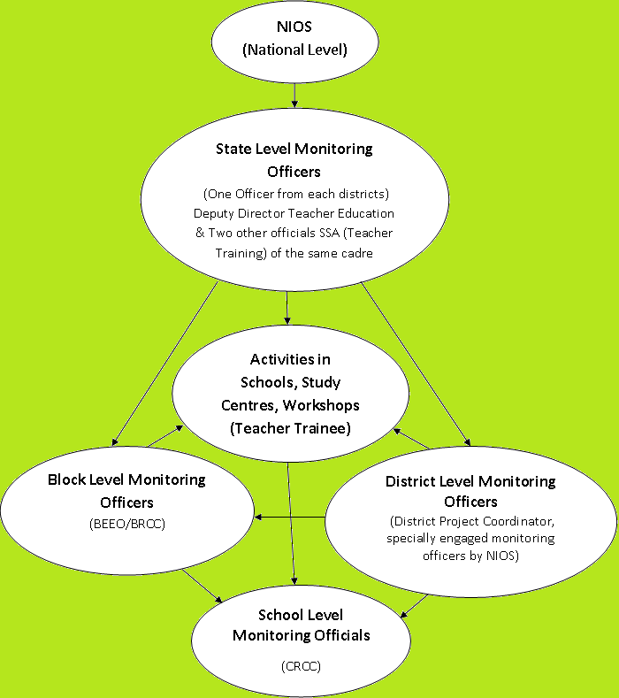
Flow Chart of Monitoring at different levels

Slide 32
THANK YOU!
nios.ac.in
dled.nios.ac.in
<number>

