Slide 1
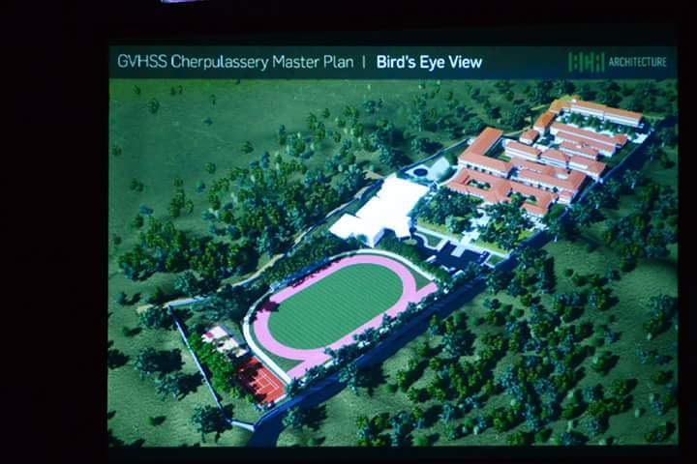
Birds eye view of proposed school SPACE -GHSS Cherpulassery and already completed HSS building as a result of comprehensive plan planning

Slide 3
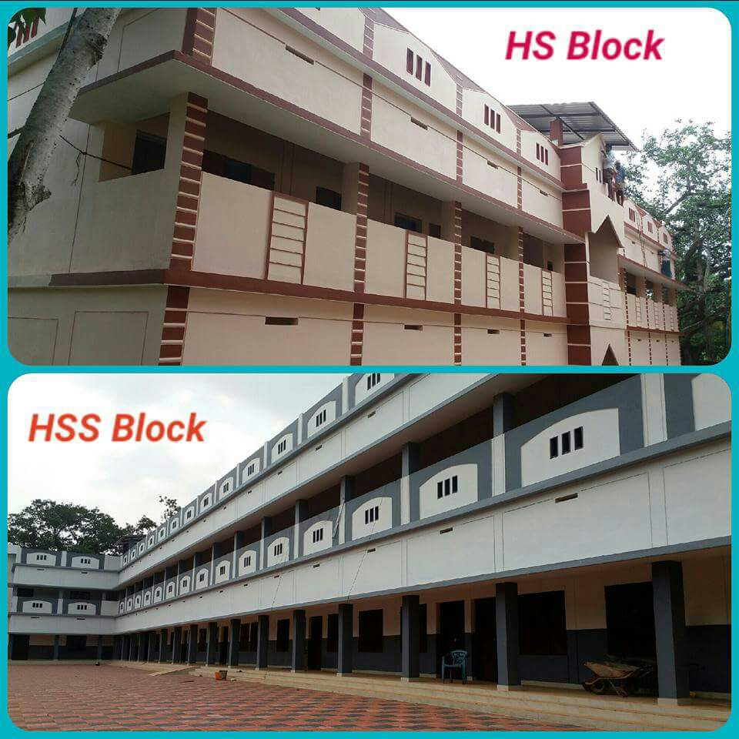

Slide 4
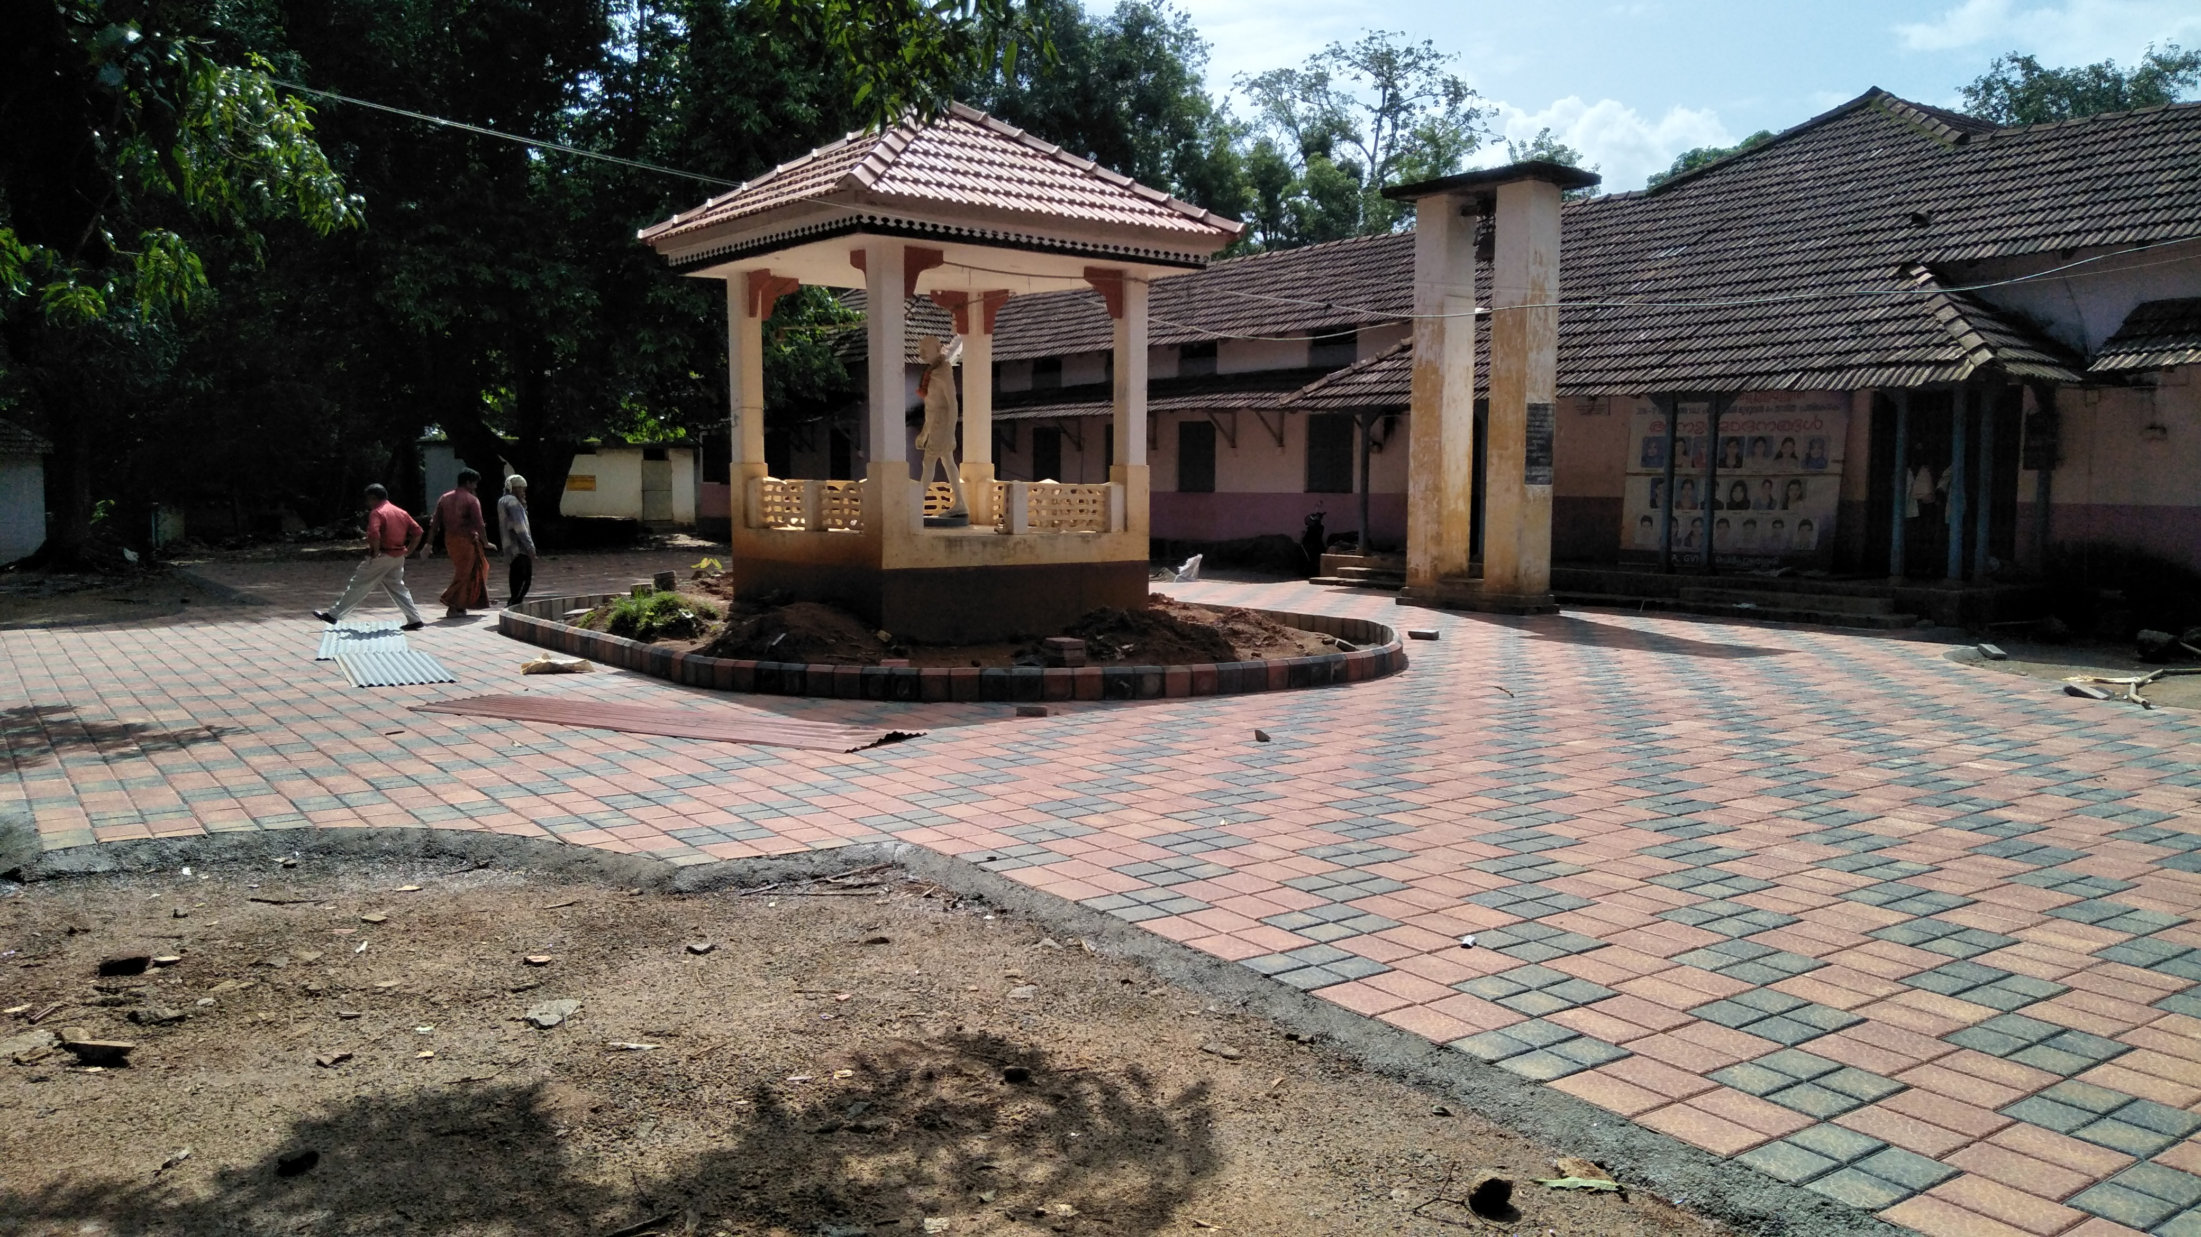

Slide 5
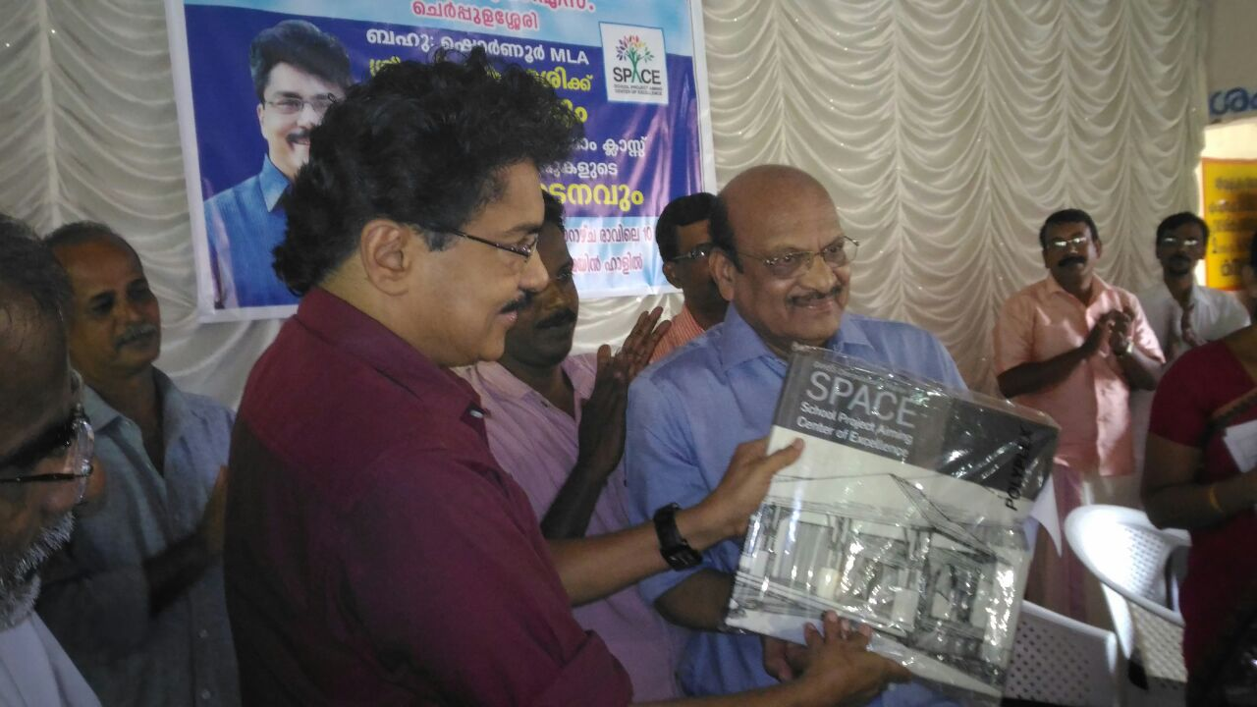

Slide 6
GHSS Agali Model school of District Panchayat Model school by District panchayat 75 Lakhs Good participation by PTA Water facility by PTA SMART ROOM by MP PINK toilet by suchitwa mission Morning food for 300 students

Slide 7
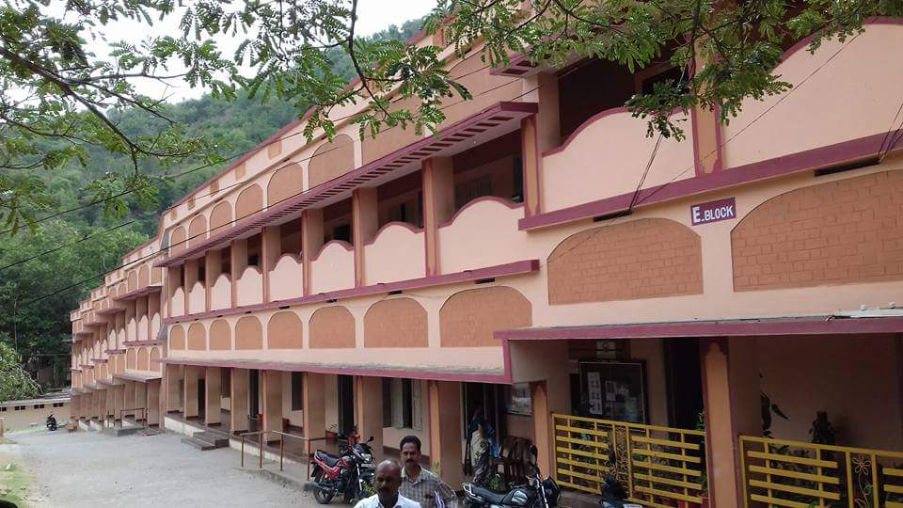

Slide 8
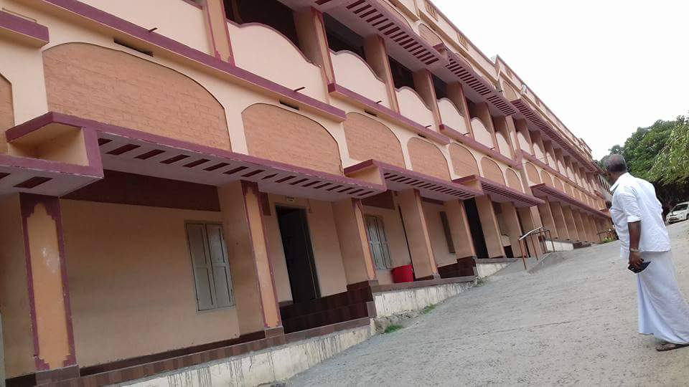

Slide 9
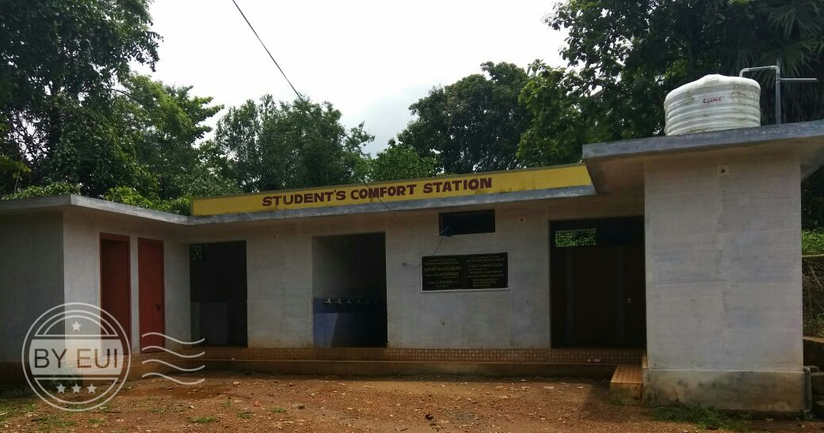
ALPS PALAKKODE changes from aided schools

Slide 10
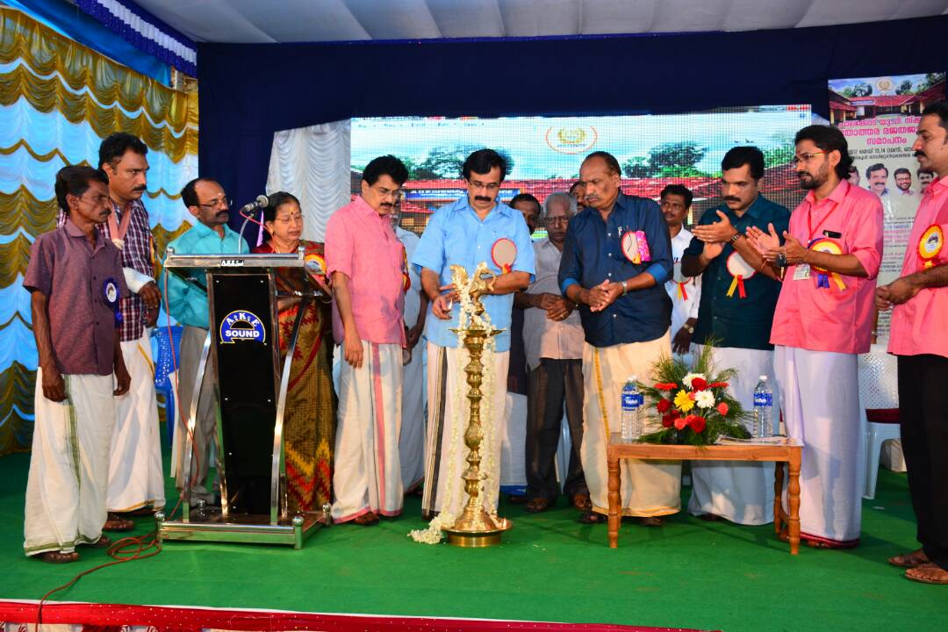

Slide 11
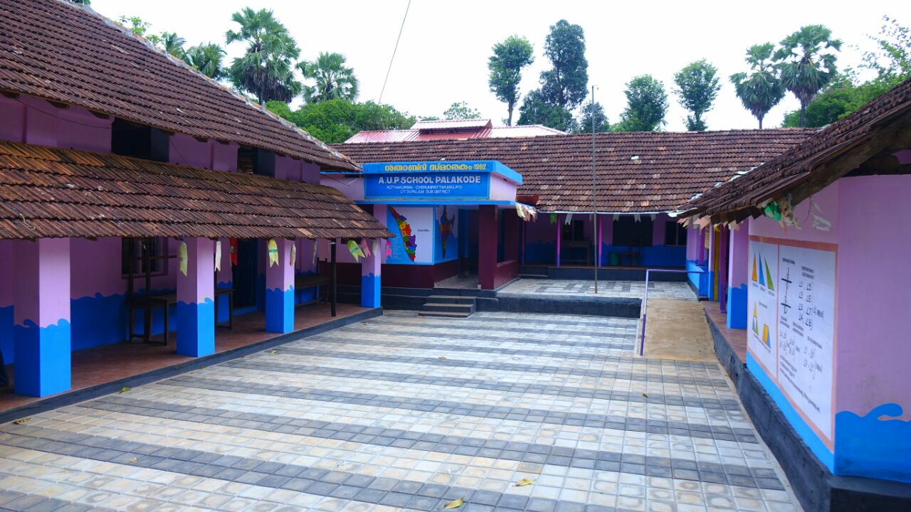

Slide 12
